Slide 1

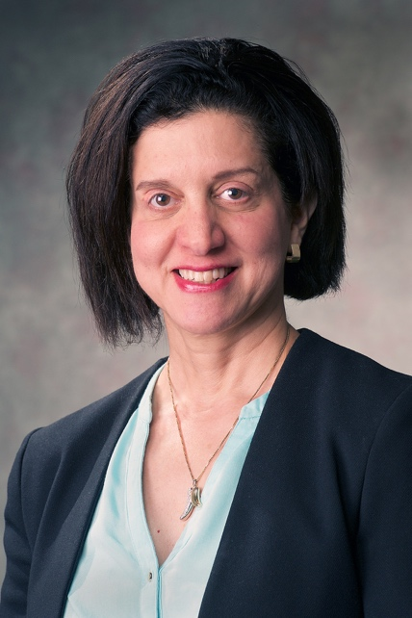
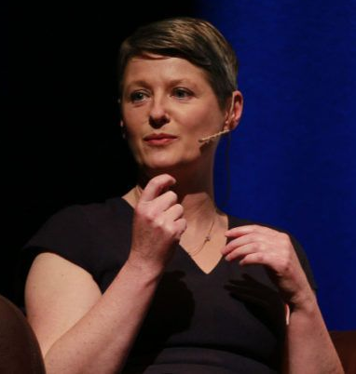
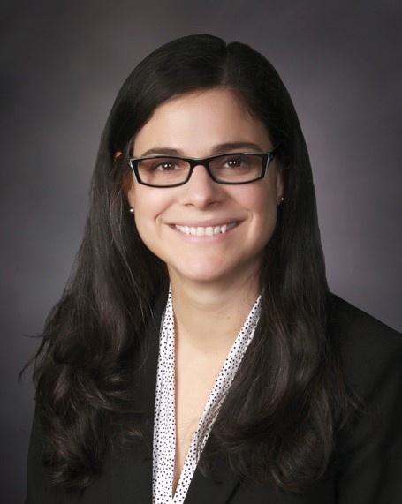
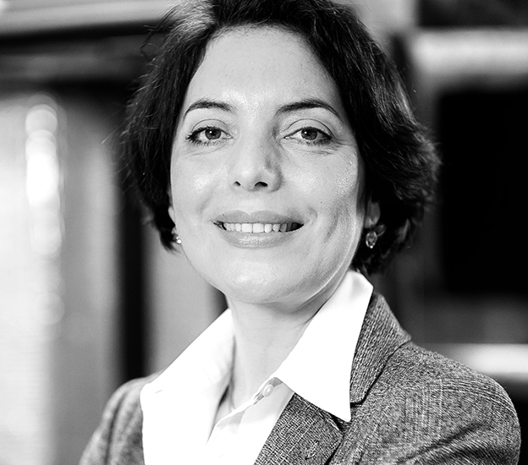
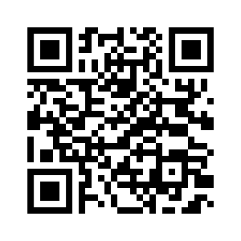
All are welcome
WO+MEN Reception
October 27^{th _} 06:00 - 08:00 PM
*Sunday 27/10/2019: 18:00 to 20:00:
The IEEE SENSORS 2019 Welcome Reception has been renamed the Wo+Men Reception. Supported by the IEEE Sensors Council WiSe Initiative, it aims to promote the presence and advancement of persons who identify as women in the technical area and professions related to sensors. It is not an event for women in SENSORS, but an opportunity for everyone to celebrate women in sensors. It will highlight the excellence of those sensors researchers and bring together all researchers, scientists, industry practitioners and other like-minded people to share ideas and debate on the issues relevant to the implication of women in different sensor fields.
Let's shape the future of sensors, together !
During the reception we will display profiles of a number of women in our sensors community, and we invite all women attending SENSORS 2019 to share their experiences by completing their profile information in the portrait template. The portraits will be displayed at both the Wo+Men reception and the Sensors Council exhibition booth for the remainder of the conference.
WiSe Panel
October 28^{th _} 01:30 - 03:30 PM
WiSe Keynote Speakers
Prof. Orly Yadid-Pecht
Calgary University
Dr. Helen Berney
Analog Devices
Prof. Ana Luisa Trejos
Western University
Dr. Margaret Magdesian
Ananda Devices
Panel Discussion: Career Opportunities In Academia, Industry and Government Laboratories
YP & WiSe Mentoring Lunch
October 29^{th _} 12:00 - 01:00 PM
The Meet-the-Expert Lunch will focus on unique issues related to young professionals and women in sensors career development. It represents an opportunity to all Young Professional and female participants to interact with experts in key areas of sensors. Participants will be assigned a table based on their relevant topics in a setting that fosters attendee/expert interactions and provides networking opportunities with leaders in the field. Experts will answer questions and lead informal dialogue to help provide guidance and direction.
WiSe

