Slide 1

ieee-sensors.org
An IEEE entity devoted to sensors, theory, design, fabrication, manufacturing, reliability and applications of devices for sensing and transducing physical, chemical, and biological phenomena, with emphasis on the electronics, physics and reliability aspects of sensors and integrated sensor-actuators.

Slide 2






About the Sensors Council
(formed in 1999)
Sensors Council is an IEEE Technical Council and unlike IEEE Societies, individuals cannot be members of a council.
However, IEEE Members can register as Sensors Council participants, receive newsletters, attend Sensors Council sponsored events, and volunteer.
Conferences
Standards
Publications
Education
Technical Activities
Networking

Slide 3

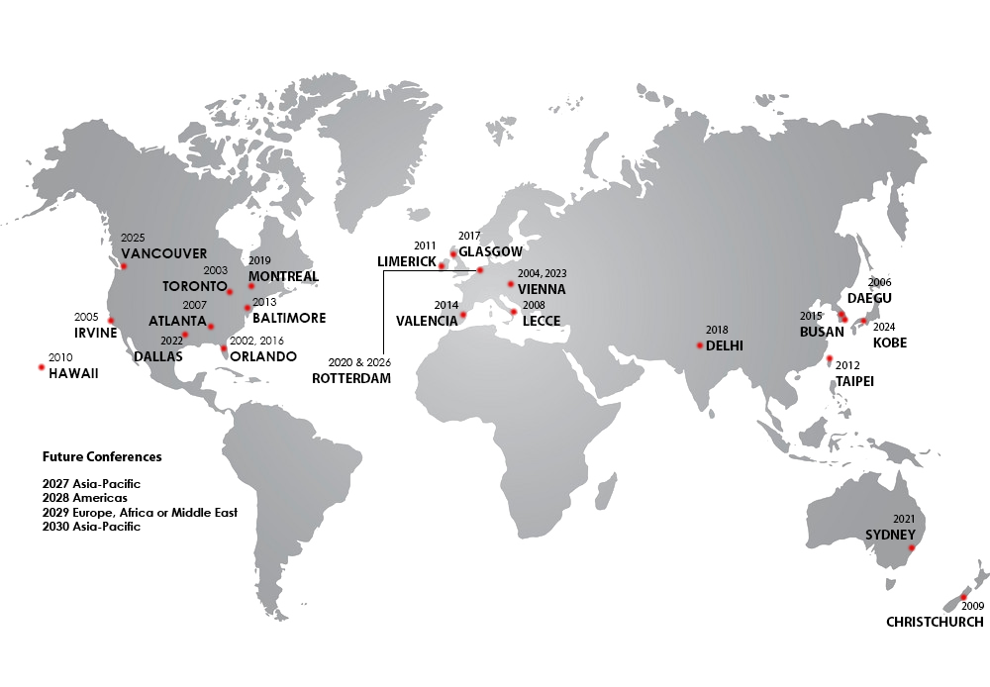
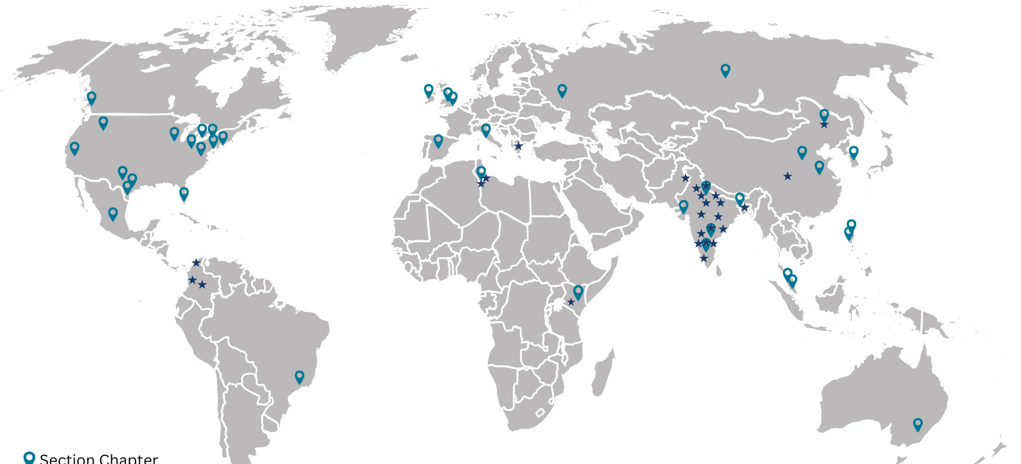
About the Council
26 Member Societies
Visit ieee-sensors.org/membership for a complete director of member societies.
45+ Section Chapters
65+ Student Branch
Chapters
SENSORS Conference Locations
3-year geographical rotation
Visit ieee-sensors.org/conferences for more info on all of the
Sensors Council’s upcoming conferences and locations.
Visit ieee-sensors.org/chapters for a full list of chapters and chair contacts.
Updated January 2024

Slide 4



Conferences
FLAGSHIP CONFERENCE
IEEE International Conference on Flexible, Printable Sensors and Systems
Singapore,
June 22 - 25, 2025
IEEE SENSORS Conference
Vancouver, Canada
October 19-22, 2025
IEEE International Symposium on Inertial Sensors and Systems
Lake Constance, Germany
May 4-7, 2025
A full list of events and conferences, call for papers, and registration information can be found on ieee-sensors.org/conferences.

Slide 5



Conferences
IEEE Applied Sensing Conference
Hyderabad, India
January 20-22, 2025
IEEE BioSensors Conference
San Diego, California, USA
August 2 - 5, 2025
IEEE Conference on Agrifood Electronics
Valencia, Spain
September, 2025
A full list of events and conferences, call for papers, and registration information can be found on ieee-sensors.org/conferences.

Slide 6


Industry Focused Events
IEEE Sensor Interfaces Meeting
Veldhoven, The Netherlands
May 12-13, 2025
IEEE Sensors in Spotlight
Boston, MA, USA
May 16, 2025

Slide 7




Publications
IEEE Sensors Journal
  Established 2001
  3M downloads in 2023
  Impact factor 4.325
IEEE Sensors Letters
  Established in 2017
  Rapid publication of short papers
Co-Sponsored Publications
  IEEE Journal on Flexible Electronics
  IEEE Internet of Things Journal
  IEEE Trans. on Agrifood Electronics
  IEEE Journal of Indoor and Seamless Positioning and Navigation
  IEEE Trans. on Radar Systems
  IEEE J-MASS
  IEEE Trans. on Big Data
  IEEE Trans. on GAMES
Newsletter
  Published quarterly
  Reach of over 25,000 subscribers
IEEE Sensors Reviews
  Established in 2024
IEEE Journal of Selected Areas in Sensors (JSAS)
  Established in 2023

Slide 8
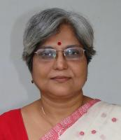
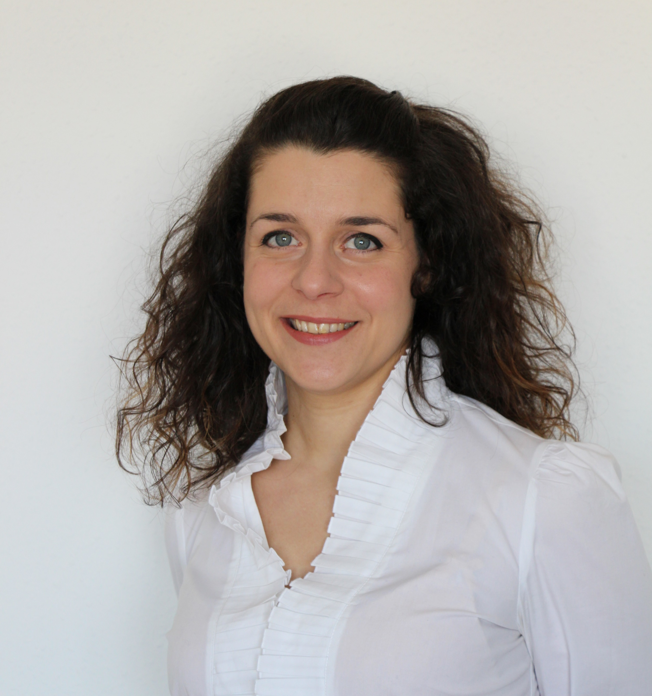
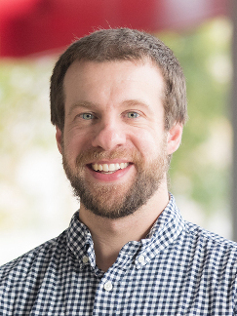
Committees
Diversity and Inclusion (D&I)
Chair: Enakshi Bhattacharya
Objective: support the Sensors Council in ensuring activities and policies are supporting a diverse and inclusive environment
Women in Sensors (WiSe)
Chair: Paola Saccomandi
Objective: promote the presence and advancement of women in the profession of sensing technology, both in industry and academia
Young Professionals (YP)
Chair: Joseph Andrews
Objective: promoting members who are within 15 years of receiving their degree by expanding their global network, elevating their professional image, and connecting to local peers

Slide 9
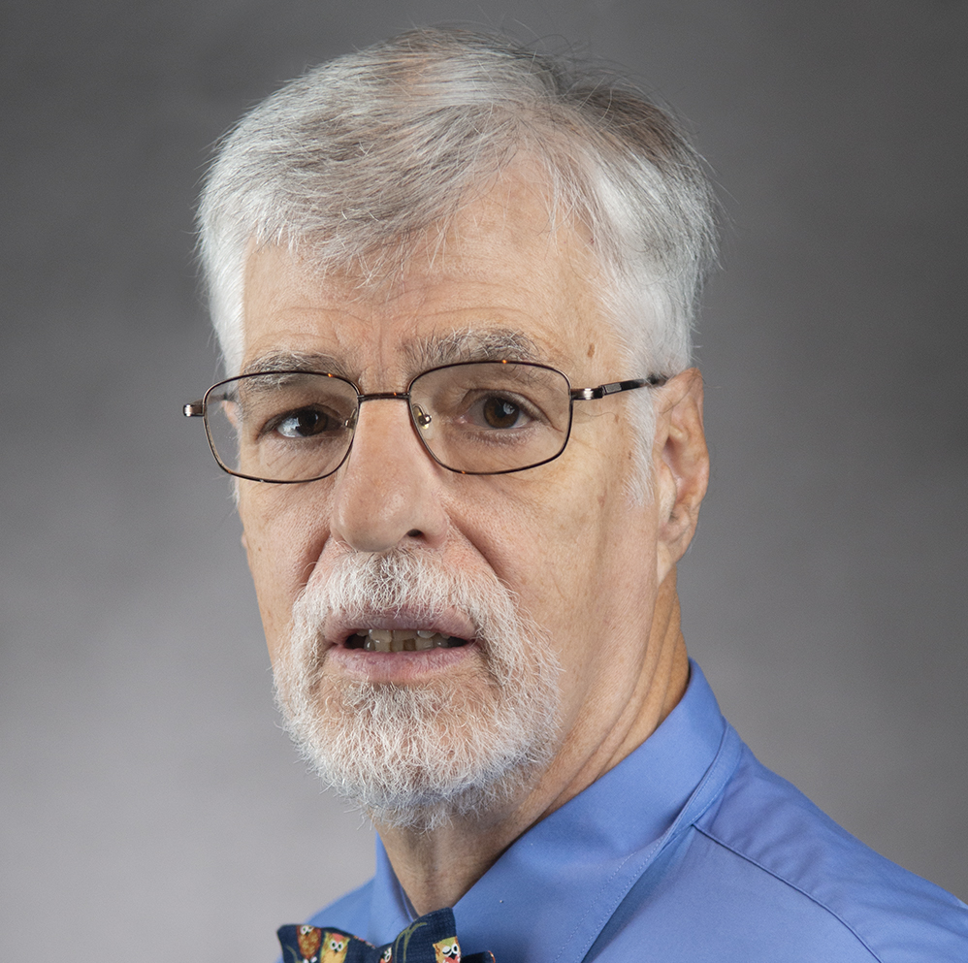
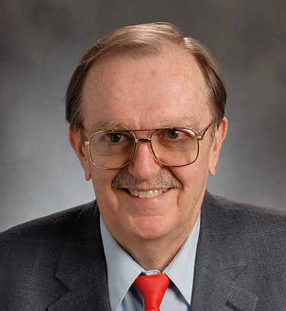
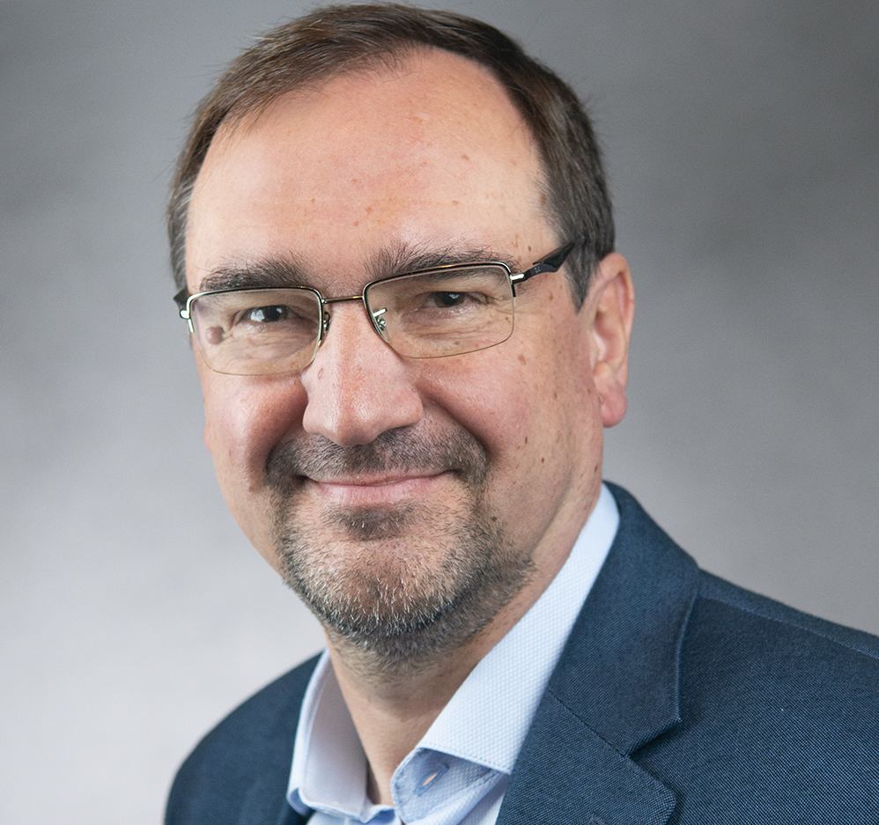
Committees
Industry Liaison Committee
Chair: Dan McGrath
Objective: drive industry engagement in sensors and establish an industry track at IEEE SENSORS
Standards Committee
Chair: Troy Nagle
Objective: to develop standards in sensors domain
SC-SC is currently developing 3 standards
Technical Committee in Inertial Sensors & Systems
Chair: Andrei Shkel
Objective: promote exchanges among researchers from academia, industry and government and identify the technologies and technical approaches to advance and mature the field of inertial sensors technology

Slide 10



Distinguished Lecturer Program 2024
Objective
Highlights
Information
Access experts promoting the field of sensors.
Currently 12 DLs with various backgrounds and geo-locations
Online Biography and Talk Titles (addition of video)
Request a Distinguished Lecturer for your event by visiting the website and filling out the form.
Calls for new DLs are announced on the website and social media.
ieee-sensors.org/distinguished-lecturer-program

Slide 11
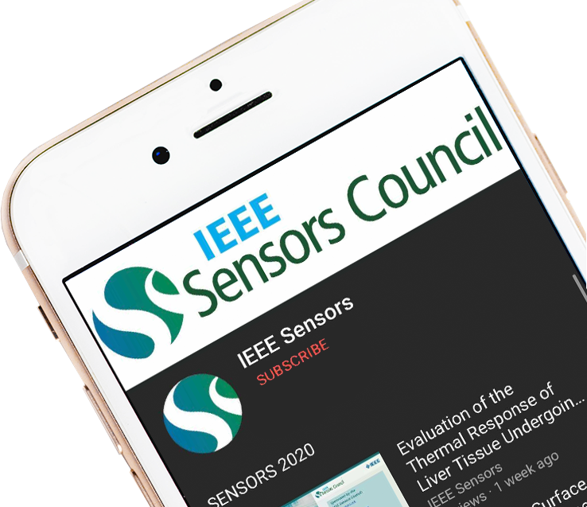

YouTube Education
The Sensors Council YouTube channel has over 316,000 views and over 6,000 subscribers as of January 2025. The channel features live demonstrations, conference tutorials, plenary talks, invited/keynote talks, oral presentations, DL talks and more.
Bit.ly/SensorsCouncilYouTube

Slide 12

IEEE Sensors Alert
IEEE Sensors Alert is an online, weekly digest which publishes teasers and condensed versions of our journal papers in layperson's language.
Read & Subscribe:
ieee-sensorsalert.org

Slide 13





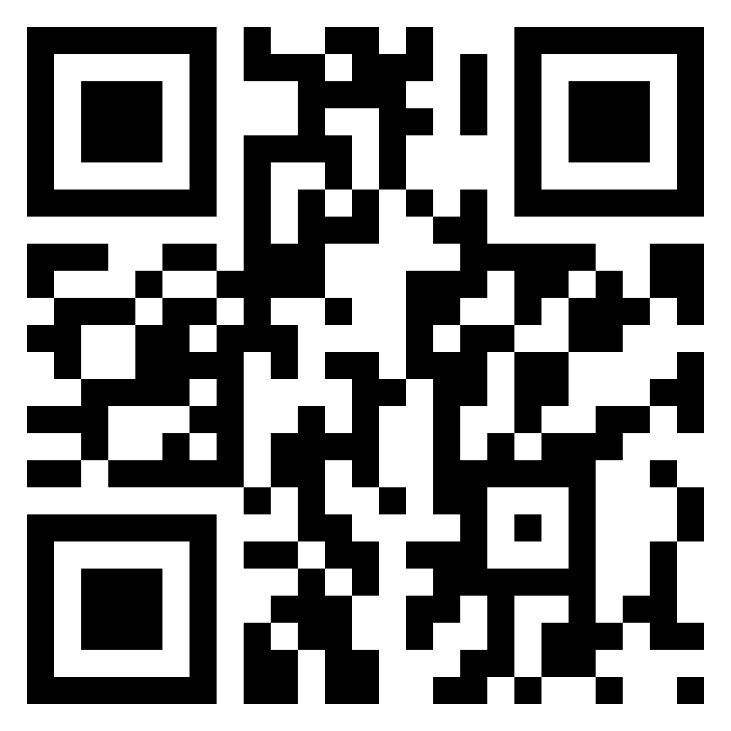


Website
ieee-sensors.org
Facebook
facebook.com/IEEESensorsCouncil
X (Twitter)
@SensorsCouncil
LinkedIn
Stay up to date on Sensors Council news and events!
linkedin.com/company/ieee-sensors-council
YouTube
Bit.ly/SensorsCouncilYouTube
Publicity Resources
ieee-sensors.org/publicity-documents/

