Slide 1

ieee-sensors.org

Slide 2
About the Sensors Council
Formed in 1999
An IEEE entity devoted to sensors, theory, design, fabrication, manufacturing, reliability and applications of devices for sensing and transducing physical, chemical, and biological phenomena, with emphasis on the electronics, physics and reliability aspects of sensors and integrated sensor-actuators.
Activities include publications, conferences, Distinguished Lecturers, and more.
Sensors are a cross-cutting subject among many IEEE disciplines.
Currently, there are 26 IEEE Member Societies represented in Sensors Council.

Slide 3
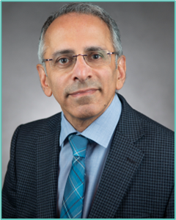
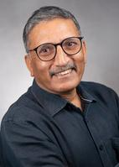
Executive Committee
President
Deepak Uttamchandani
President-Elect
Anil Roy
Past President
Ravinder Dahiya
Past Past President
Andrei Shkel
VP Finances
Srinivas Tadigadapa
VP Publications
Chonggang Wang
VP Technical Operations
Thilo Sauter
VP Conferences
Rolland Vida
VP Educational Activities
Krikor Ozanyan
Secretary - Treasurer
JB Lee

Slide 4






What Can the Council Do For You?
As Sensors Council is an IEEE Technical Council and unlike Member Societies, individuals cannot be members of a council. However, IEEE Members can register as Sensors Council participants, receive newsletters, attend Sensors Council sponsored events, and volunteer.
Conferences
Standards
Publications
Education
Technical Activities
Networking

Slide 5

Sensors Council’s 26 Member Societies

Slide 6



Conferences
FLAGSHIP CONFERENCE
IEEE International Conference on Flexible, Printable Sensors and Systems
Singapore
June 22-25, 2025
IEEE SENSORS Conference
Vancouver, Canada
October 19-22, 2025
IEEE International Symposium on Inertial Sensors and Systems
Lake Constance, Germany
May 4-7, 2025
A full list of events and conferences, call for papers, and registration information can be found on ieee-sensors.org/conferences.

Slide 7



Conferences
IEEE Applied Sensing Conference
Hyderabad, India
January 20-22, 2025
IEEE BioSensors Conference
San Diego, CA, USA
August 2-5, 2025
IEEE Conference on Agrifood Electronics
Montevideo, Uruguay
October 2025
A full list of events and conferences, call for papers, and registration information can be found on ieee-sensors.org/conferences.

Slide 8


Industry Focused Events
IEEE Sensor Interfaces Meeting
Veldhoven, Netherlands
May 12-13, 2025
IEEE Sensors in Spotlight
Boston, MA, USA
May 9, 2025

Slide 9
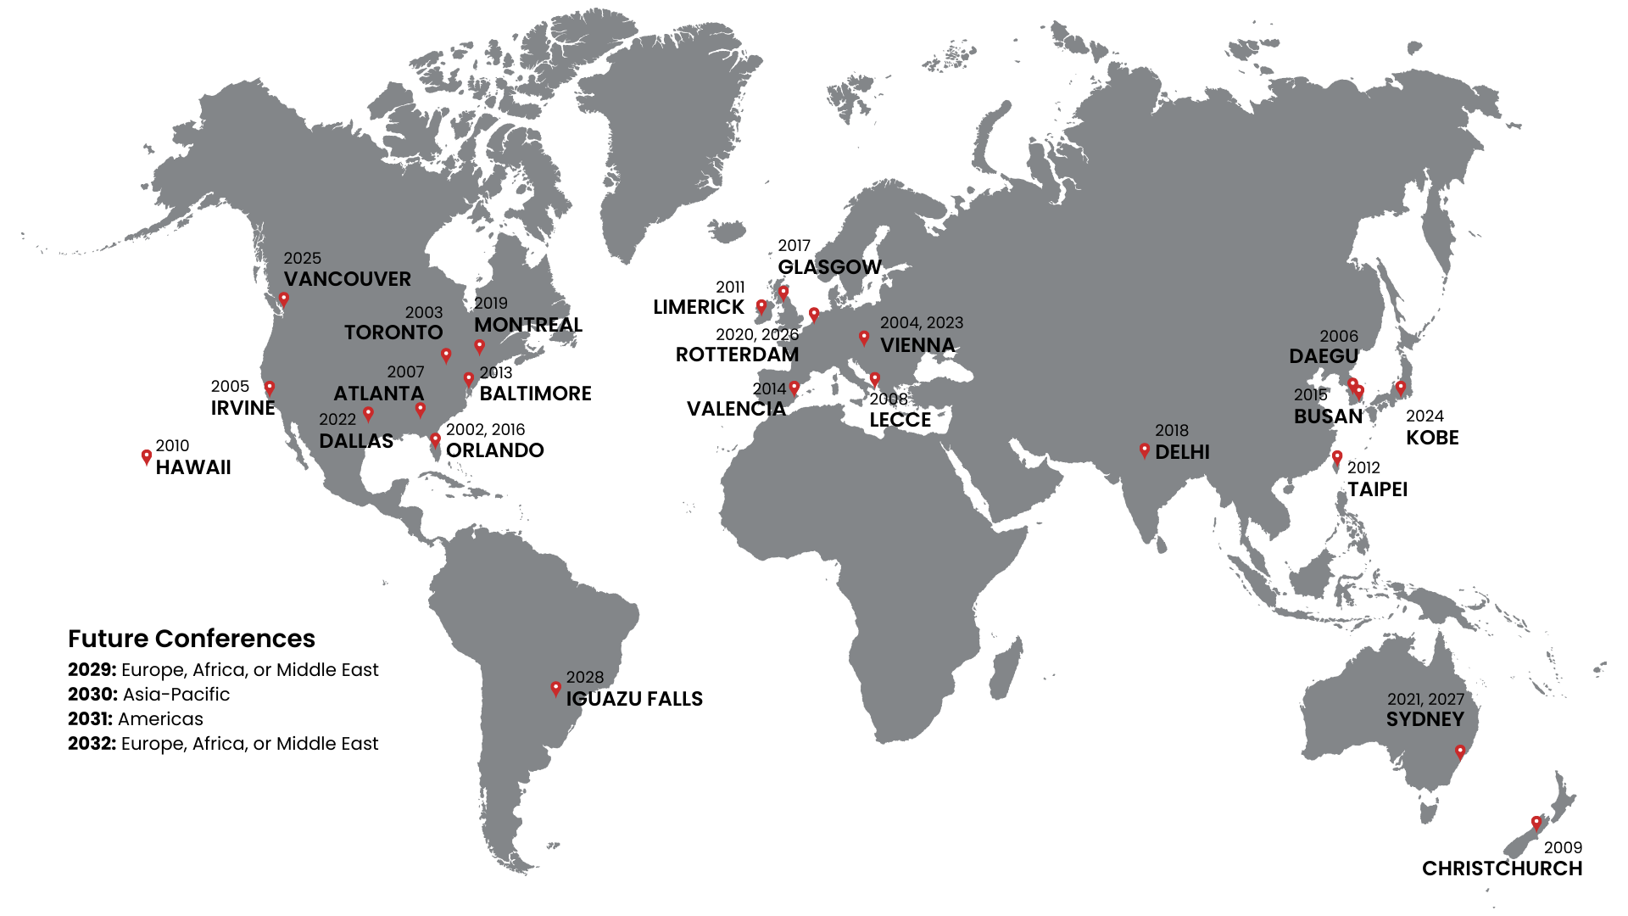

IEEE SENSORS Conference Locations
3-Year International Geographic Rotation
Americas
Europe/Middle-East/Africa
Asia/Pacific

Slide 10




Publications
IEEE Sensors Journal
  Established 2001
  3M downloads in 2023
  Impact factor 4.325
IEEE Sensors Letters
  Established in 2017
  Rapid publication of short papers
Co-Sponsored Publications
  IEEE Journal on Flexible Electronics
  IEEE Internet of Things Journal
  IEEE Trans. on Agrifood Electronics
  IEEE Journal of Indoor and Seamless Positioning and Navigation
  IEEE Trans. on Radar Systems
  IEEE Trans. on Big Data
  IEEE Trans. on GAMES
Newsletter
  Published quarterly
  Reach of over 25,000 subscribers
IEEE Sensors Reviews
  Established in 2024
IEEE Journal of Selected Areas in Sensors (JSAS)
  Established in 2023

Slide 11

IEEE Sensors Alert
IEEE Sensors Alert is an online, weekly digest which publishes teasers and condensed versions of our journal papers in layperson's language.
Read & Subscribe:
ieee-sensorsalert.org

Slide 12
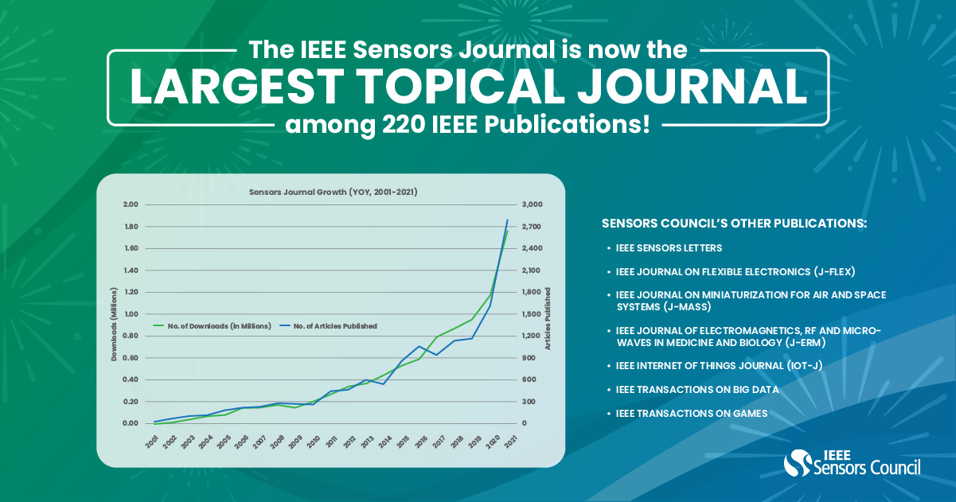
IEEE Sensors Journal

Slide 13
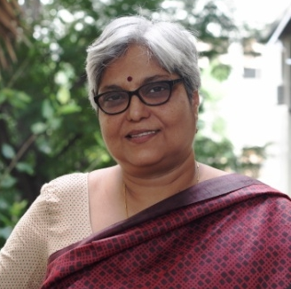
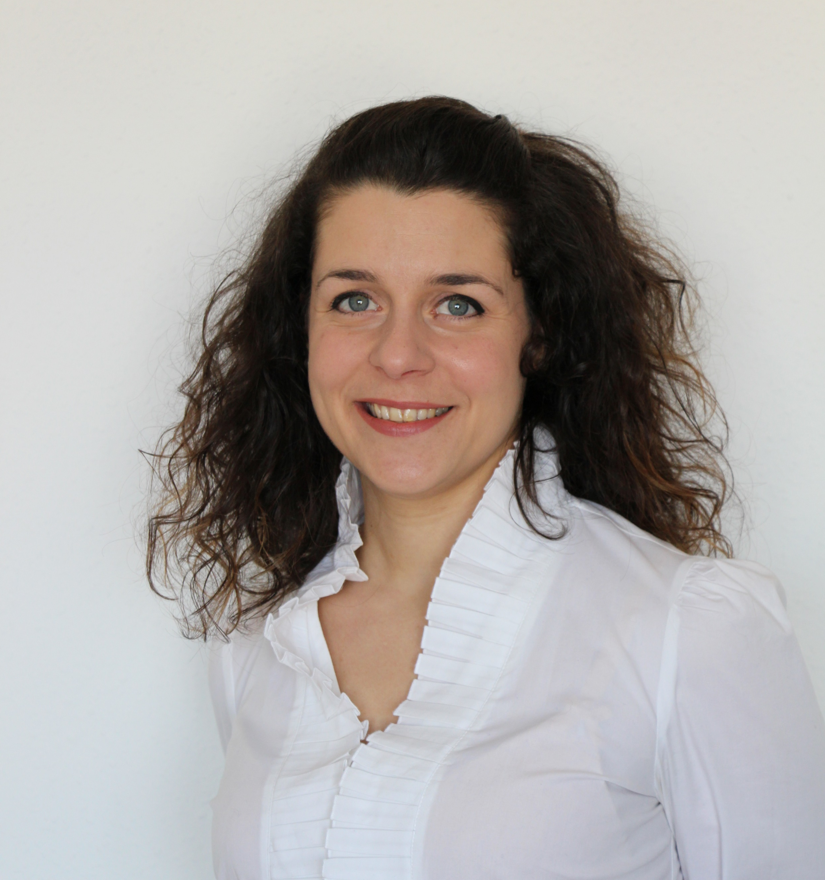
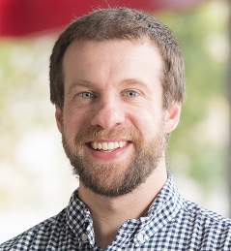
Committees
Diversity and Inclusion (D&I)
Chair: Enakshi Bhattacharya
Objective: support the Sensors Council in ensuring activities and policies are supporting a diverse and inclusive environment
Women in Sensors (WiSe)
Chair: Paola Saccomandi
Objective: promote the presence and advancement of women in the profession of sensing technology, both in industry and academia
Young Professionals (YP)
Chair: Joseph Andrews
Objective: promoting members who are within 15 years of receiving their degree by expanding their global network, elevating their professional image, and connecting to local peers

Slide 14
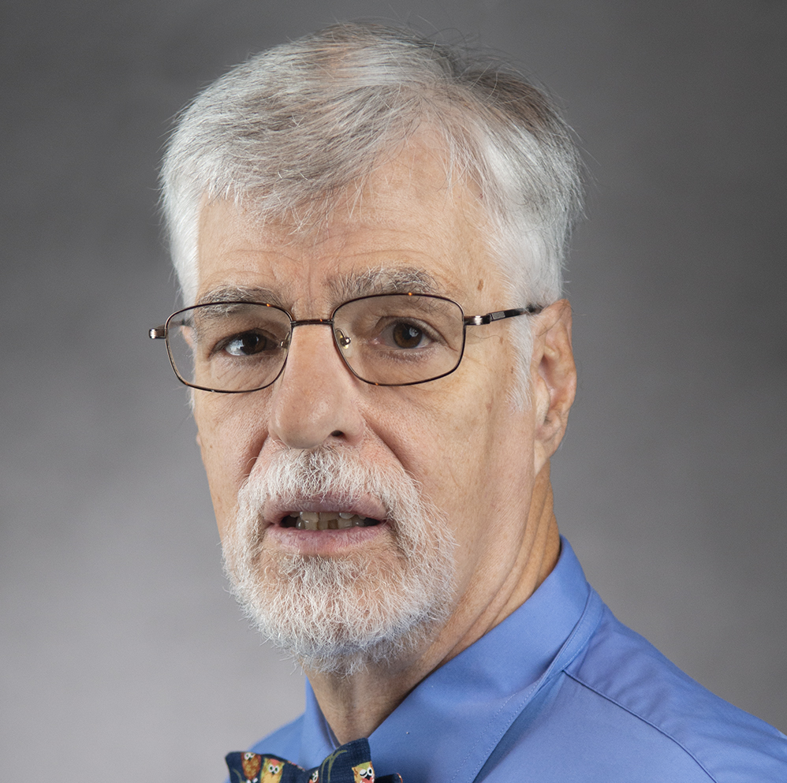
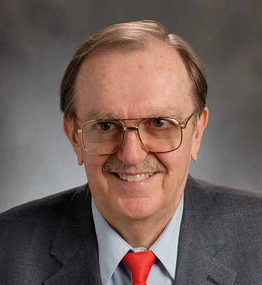
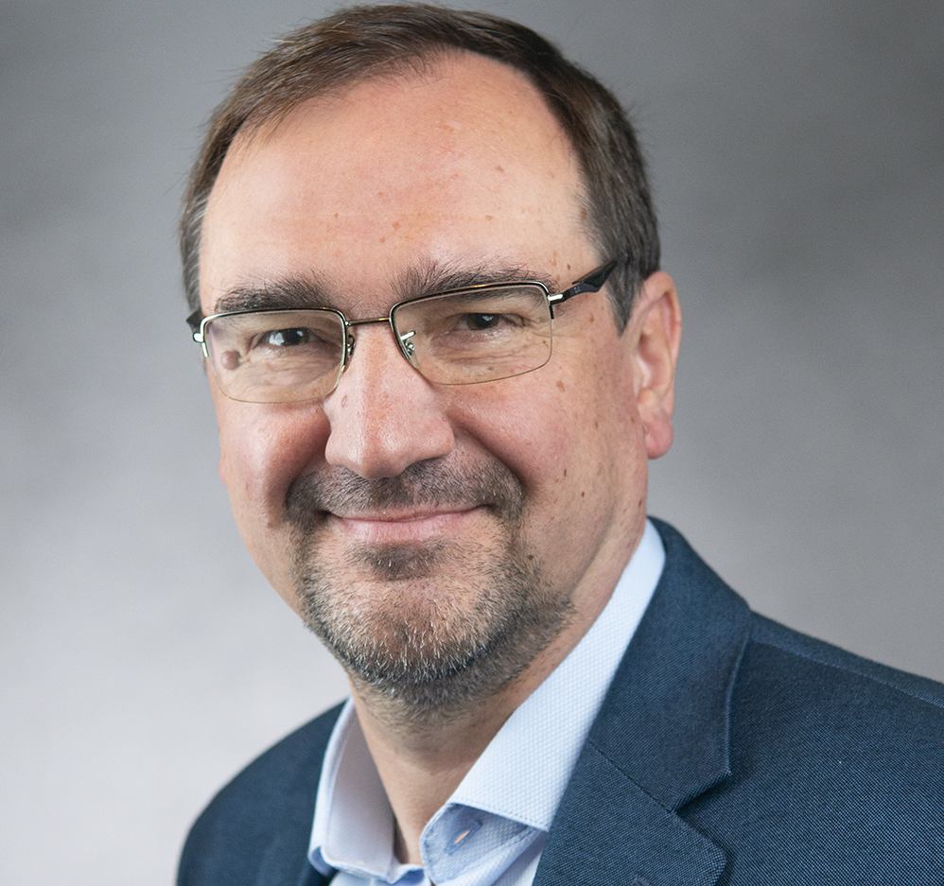
Committees
Industry Liaison Committee
Chair: Dan McGrath
Objective: drive industry engagement in sensors and establish an industry track at IEEE SENSORS
Standards Committee
Chair: Troy Nagle
Objective: to develop standards in sensors domain
SC-SC is currently developing 3 standards
Technical Committee in Inertial Sensors & Systems
Chair: Andrei Shkel
Objective: promote exchanges among researchers from academia, industry and government and identify the technologies and technical approaches to advance and mature the field of inertial sensors technology

Slide 15
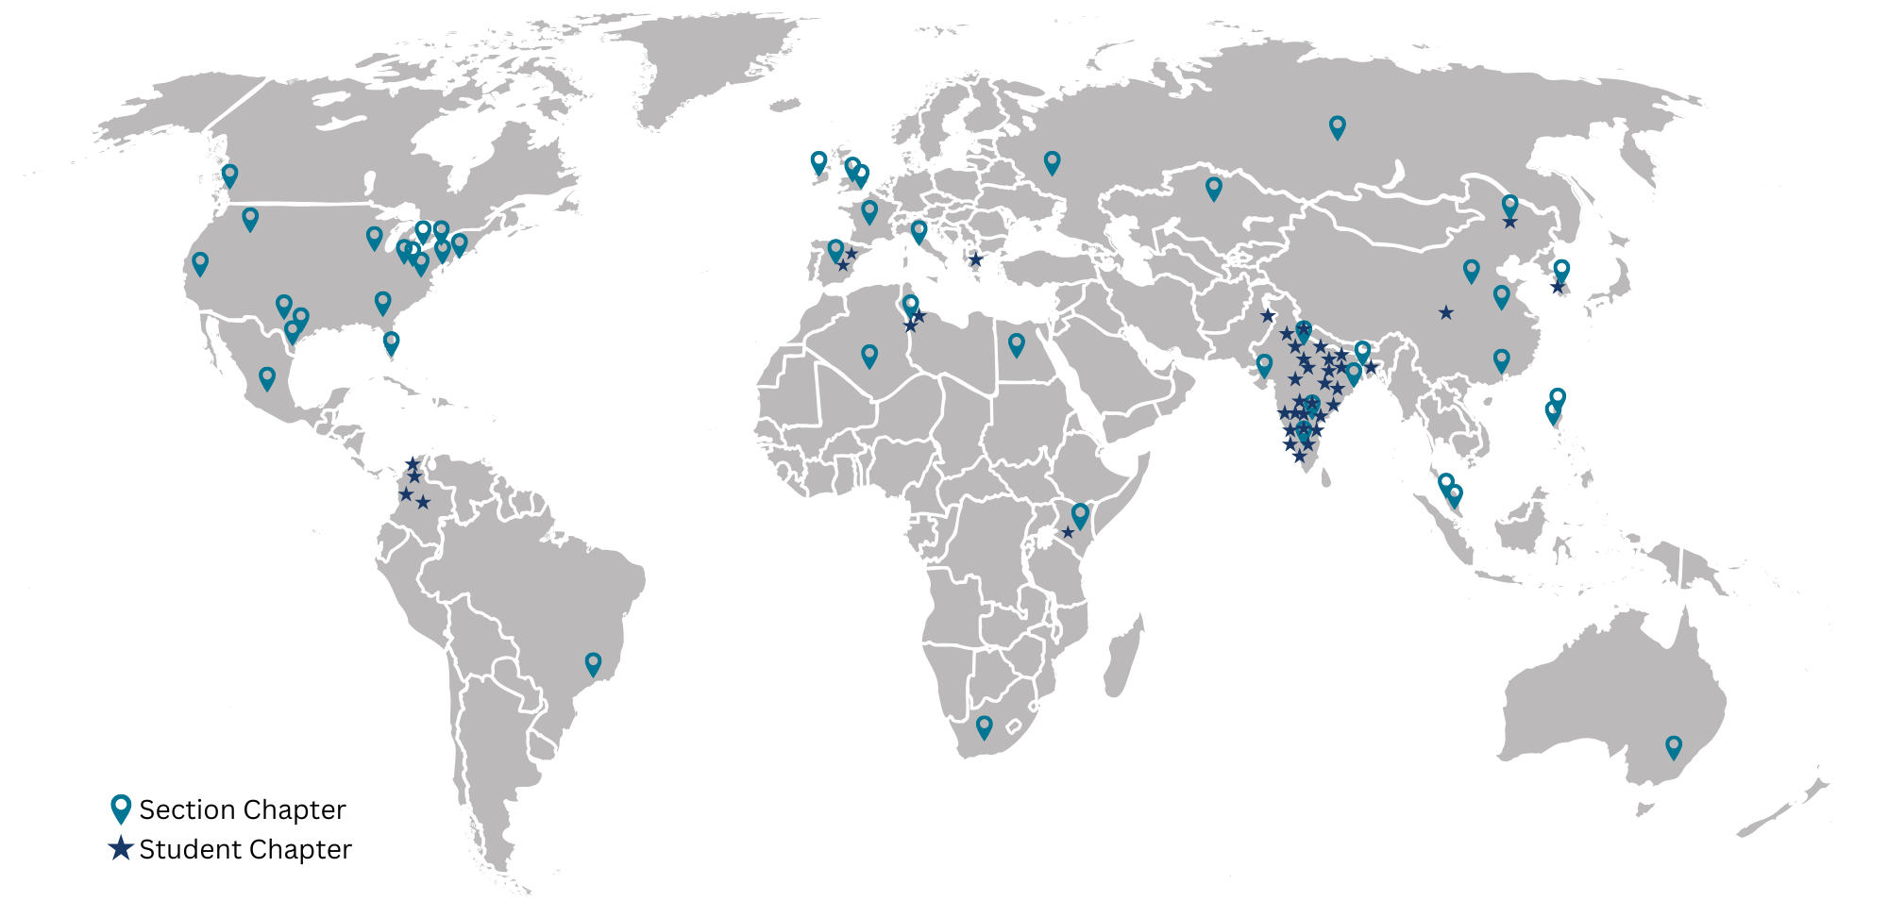
IEEE Sensors Council Chapters/Joint Chapter Locations
(as of November 2024)
45+
Section Chapters
65+
Student Branch Chapters
24
Countries
10
IEEE Regions

Slide 16



Distinguished Lecturer Program 2025
Objective
Highlights
Information
Access experts promoting the field of sensors.
Currently 12 DLs with various backgrounds and geo-locations
Online Biography and Talk Titles (addition of video)
Request a Distinguished Lecturer for your event by visiting the website and filling out the form.
Calls for new DLs are announced on the website and social media.
ieee-sensors.org/distinguished-lecturer-program

Slide 17
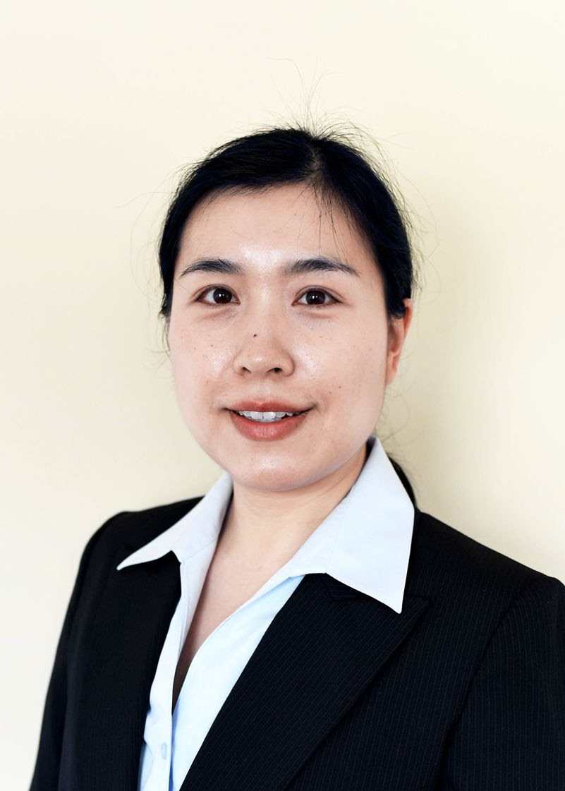
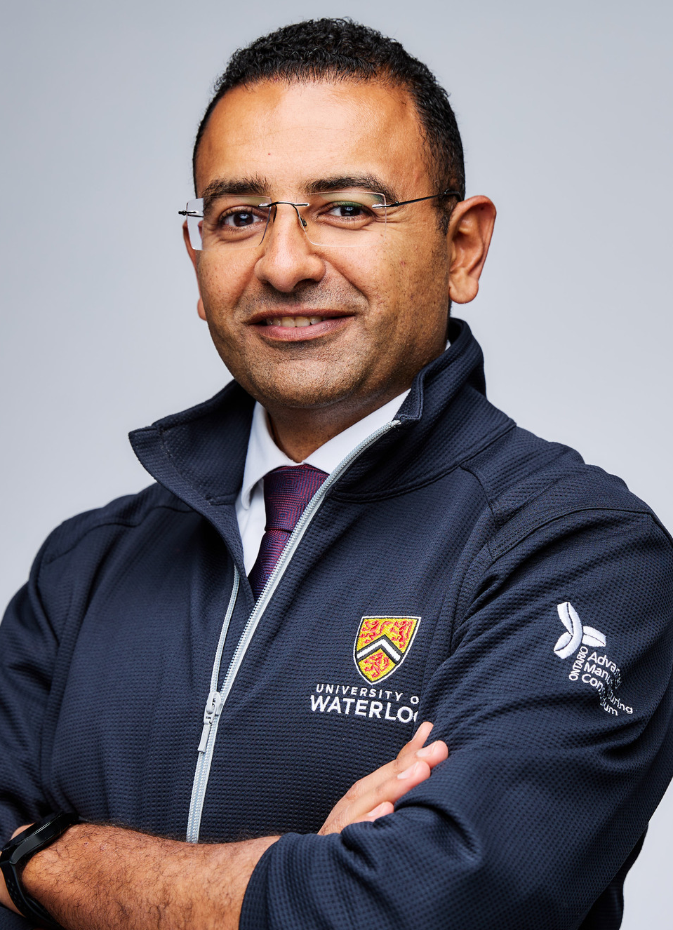
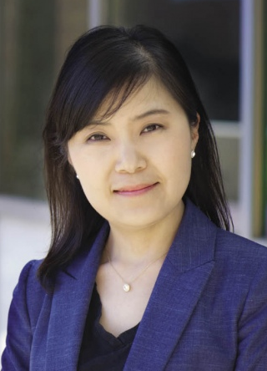
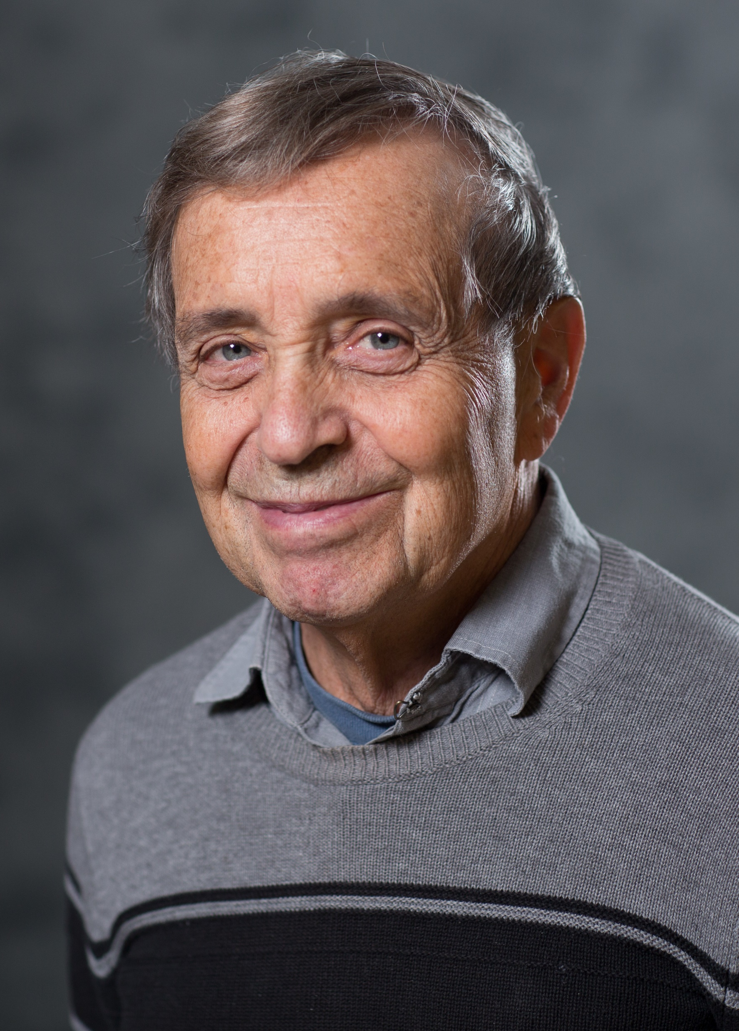
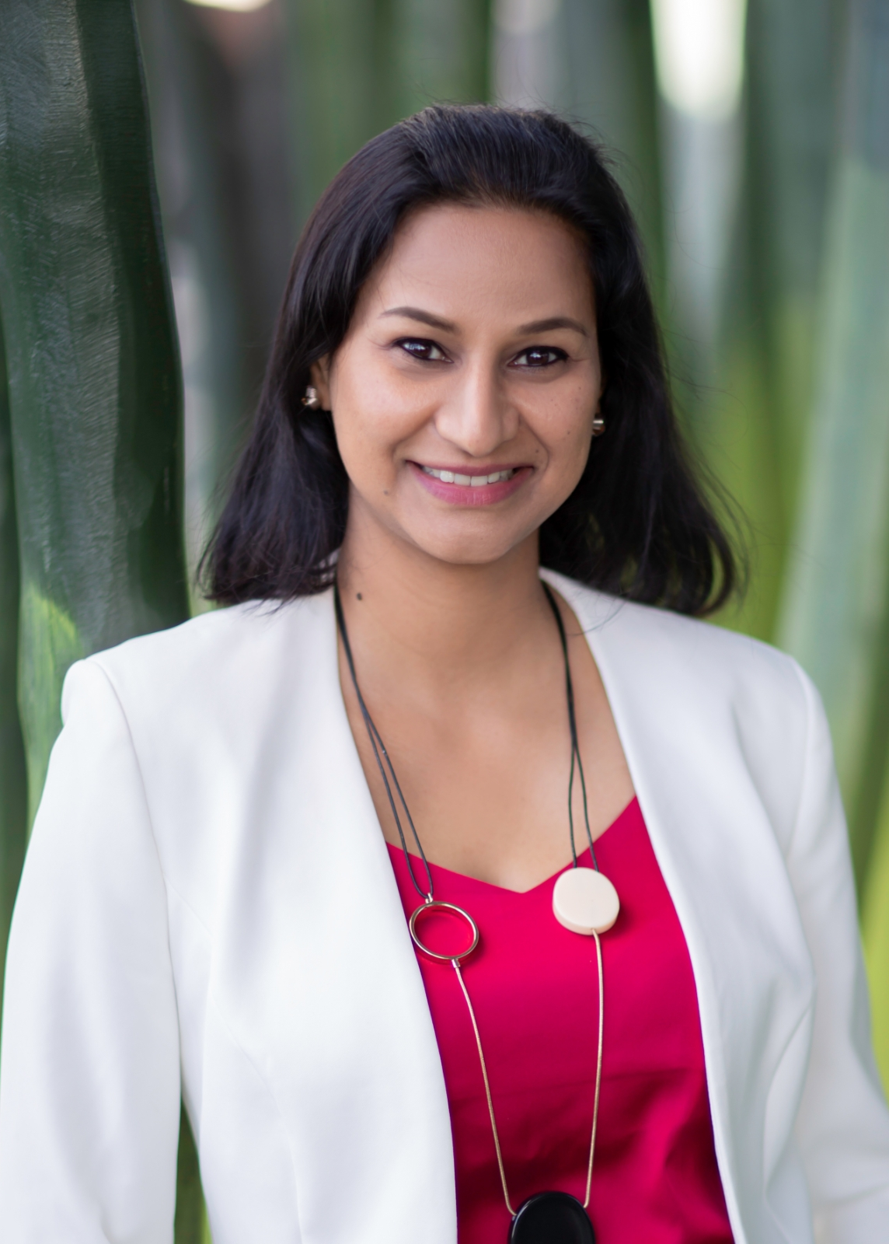

Distinguished Lecturer Program | Class of 2025-2027
Beibei Wang
Origin AI, USA
Wi-Fi Can Do More: Towards Ubiquitous Wireless Sensing
George Shaker
University of Waterloo, Canada
Next-Generation Wireless IoT: Leveraging Radar Sensors & Artificial Intelligence for Transformative Healthcare, Autonomous Systems, and Beyond
Hyejin Moon
University of Texas at Arlington, USA
Digital Microfluidics as a Chemical and Biological Sensing Platform
Michael Shur
Rensselaer Polytechnic Institute, USA
Terahertz Sensing Technology
Shweta Agarwala
Aarhus University, Denmark
Flexible, Biodegradable, and Bioresorbable Electronics: The Future of Green Technology
From E-Waste to Eco-Wonder: Sustainable Electronics for a Healthier Planet

Slide 18
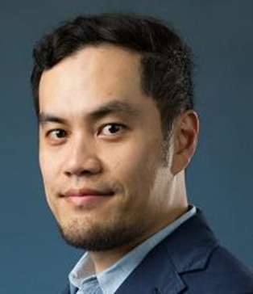
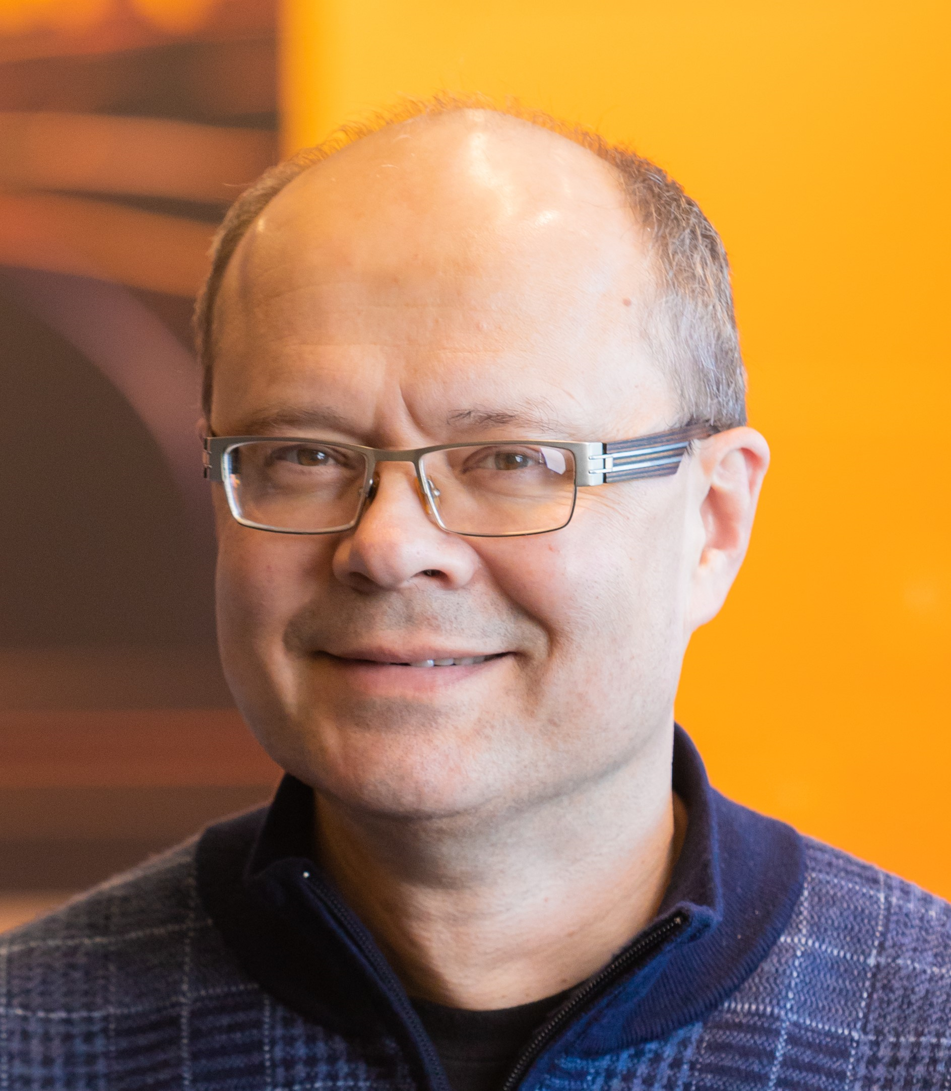
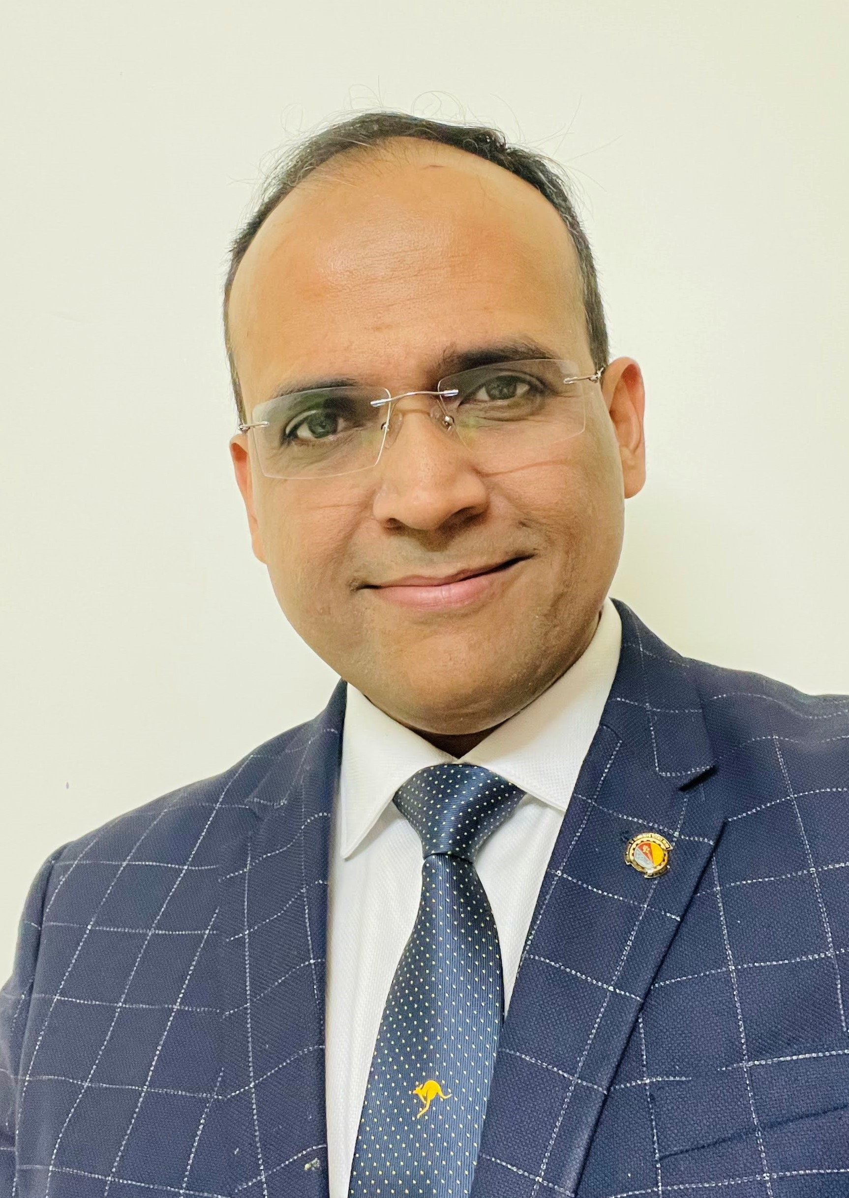
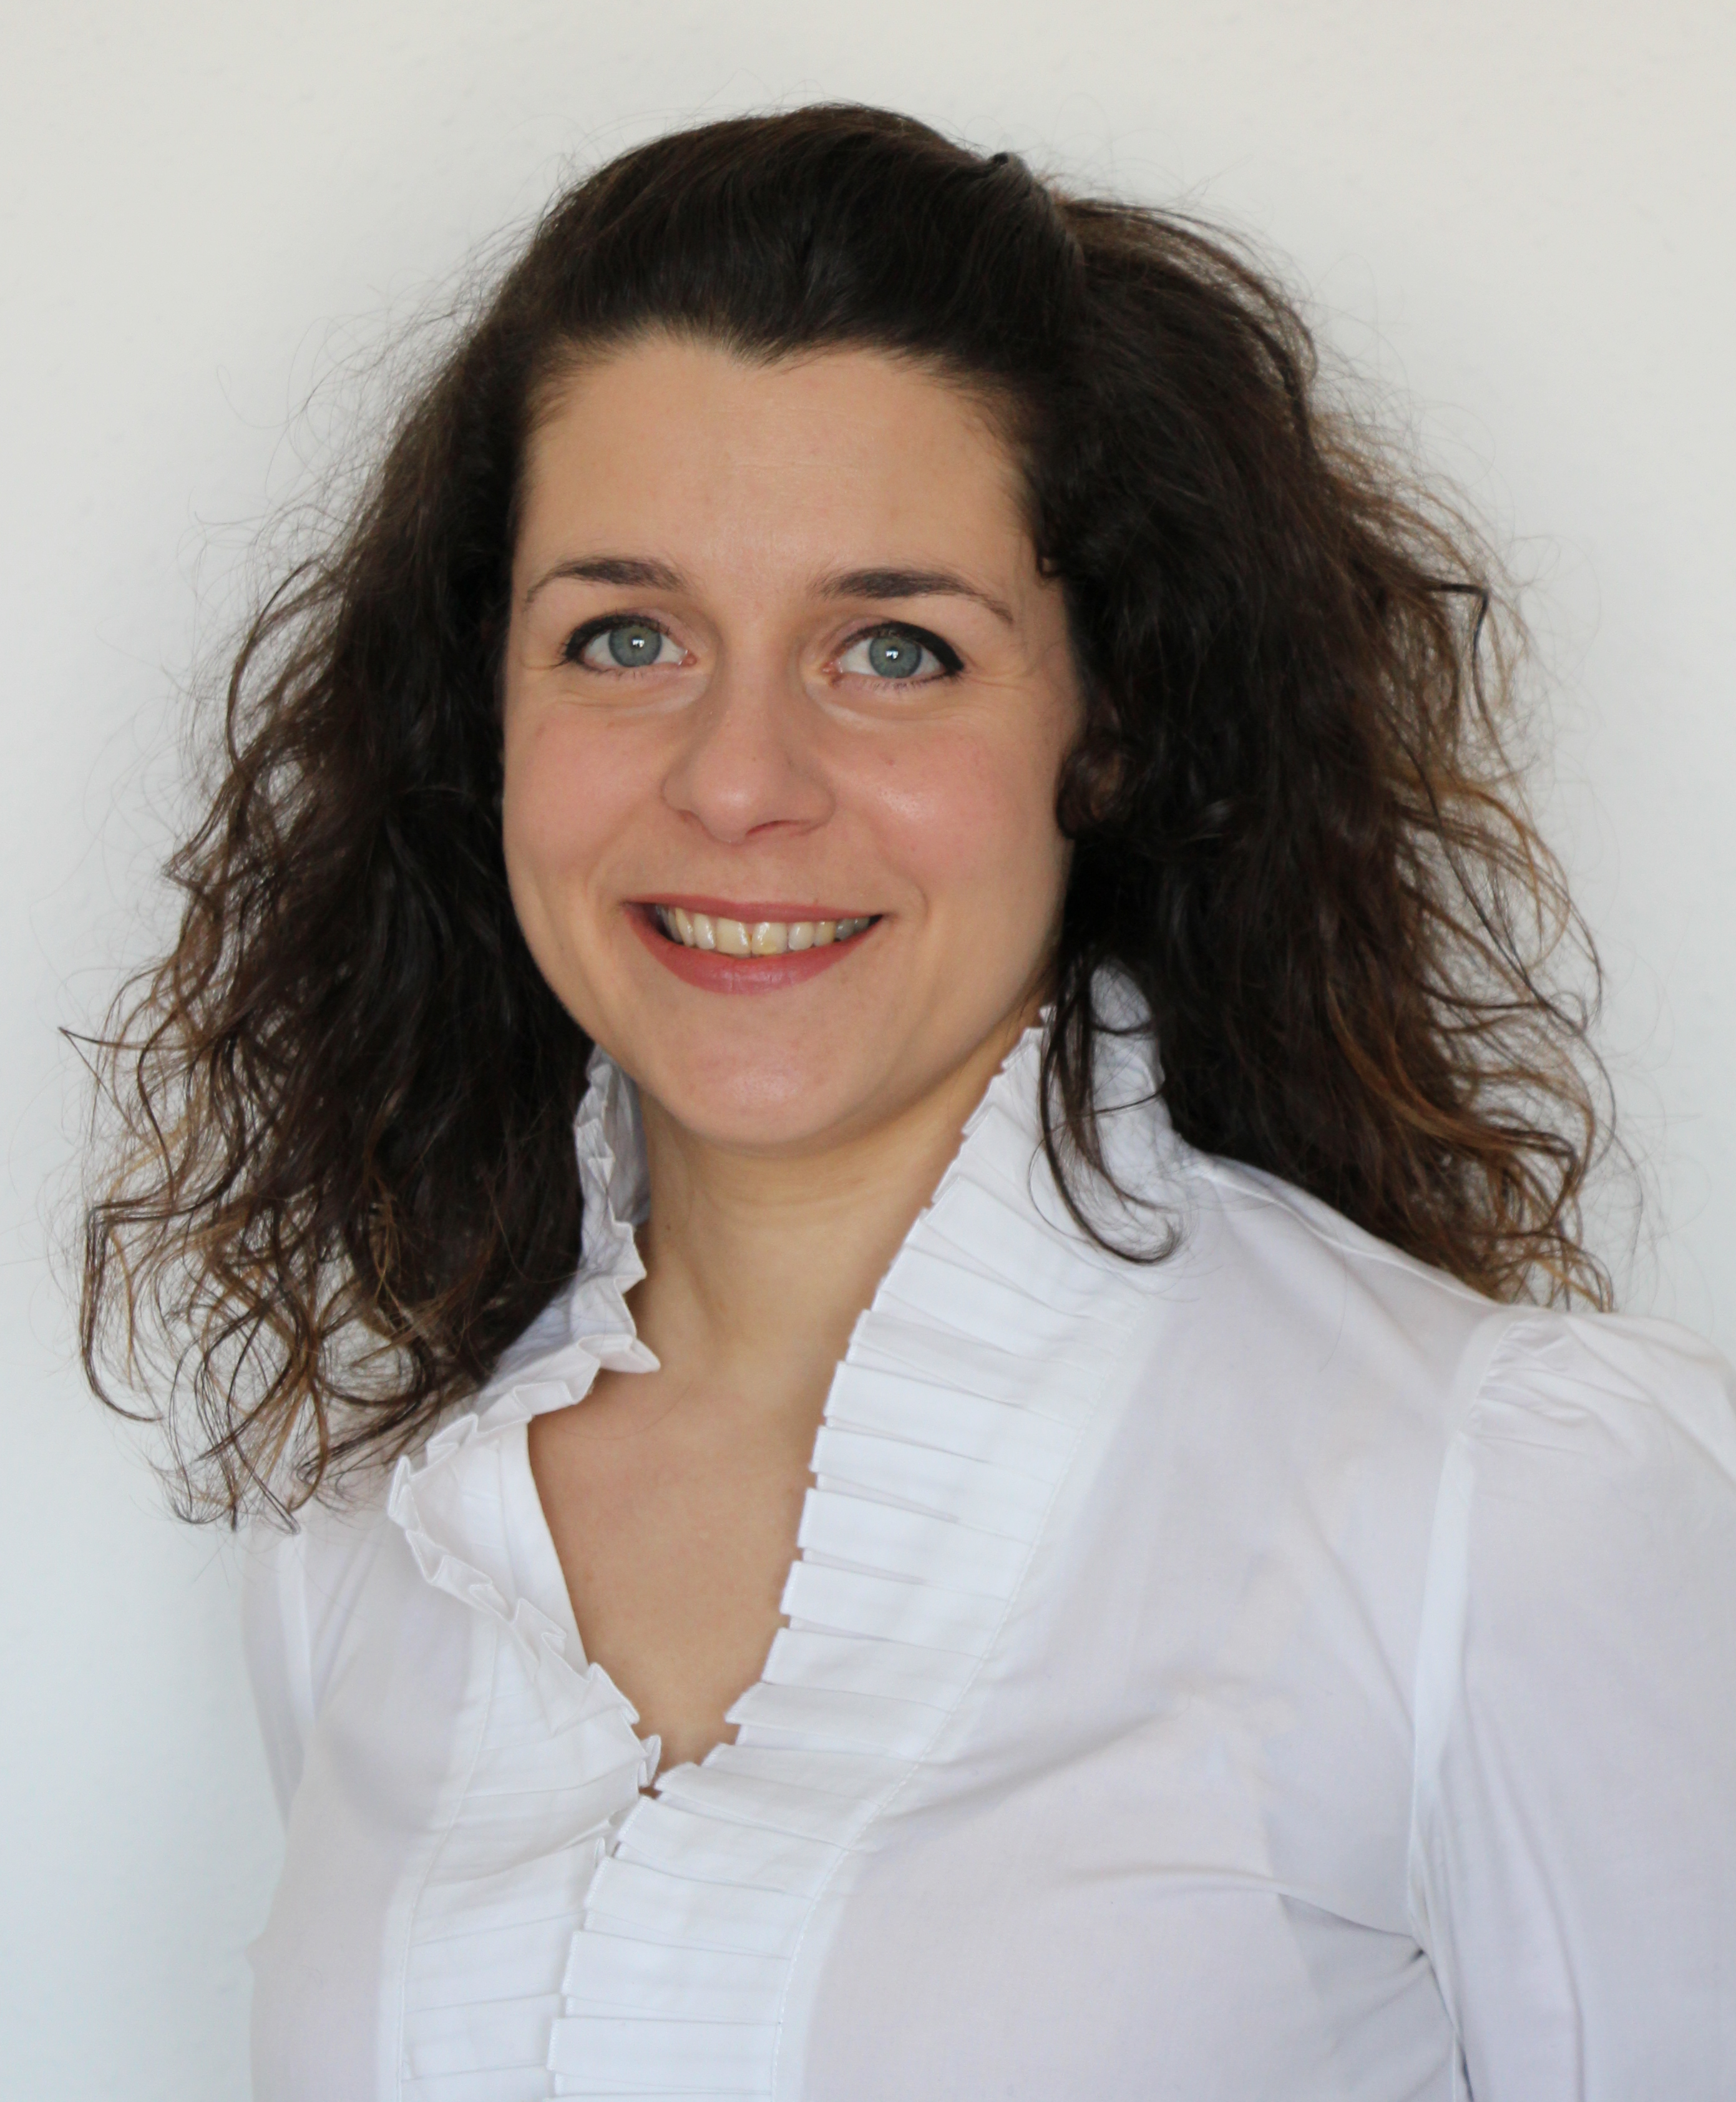
Distinguished Lecturer Program | Class of 2024-2026
Pai-Yen Chen
University of Illinois
Chicago, Illinois, USA
Zero-Power Wireless Micro- Nano-Sensors for Internet-of-Things Applications
Radislav Potyrailo
GE Research
Niskayuna, NY, USA
Next Generation of Gas Sensors: Anticipated and Unanticipated Advantages Over Last-Century Designs
Unconventional Excitation of Interfaces Enables Exquisite Gas Sensing For Our Sustainable Future
Sanket Goel
Birla Institue of Technology and Science (BITS)
Pilani, Hyderabad, India
Human-Robot Interaction and Human-Robot Teams
Portable Optofluidic Devices for Autonomous and Diversified Sensing Applications
Paola Saccomandi
Politecnico di Milano
Milan, Italy
The new thermometry with light: fiber optic sensors and novel imaging technologies for monitoring thermal-based therapies for localized tumors
Fiber optic sensors for healthcare applications: fundamentals, applications and frontiers

Slide 19
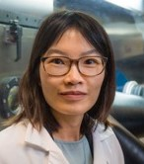
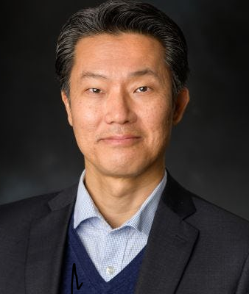
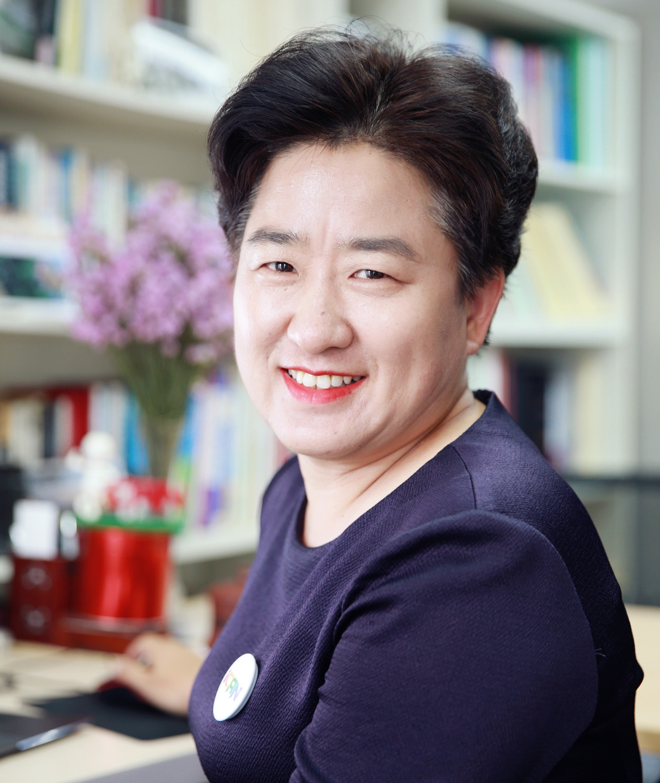
Distinguished Lecturer Program | Class of 2023-2025
Tina Tse Nga Ng
University of California
San Diego, USA
Emerging Designs for Polymer-Based Optoelectronics and Wearables
Eui-Hyeok Yang
Stevens Institute of Technology
New Jersey, USA
2D Materials and Flexible Electrodes for Sensing Applications
Haixia (Alice) Zhang
Peking University
Beijing, China
From Alice to Alita: Adventure of Self-Powered Smart System

Slide 20


YouTube Education
The Sensors Council YouTube channel has over 360,000 views and over 5,750 subscribers as of Nov. 2024. The channel features live demonstrations, conference tutorials, plenary talks, invited/keynote talks, oral presentations, DL talks and more.
Bit.ly/SensorsCouncilYouTube

Slide 21





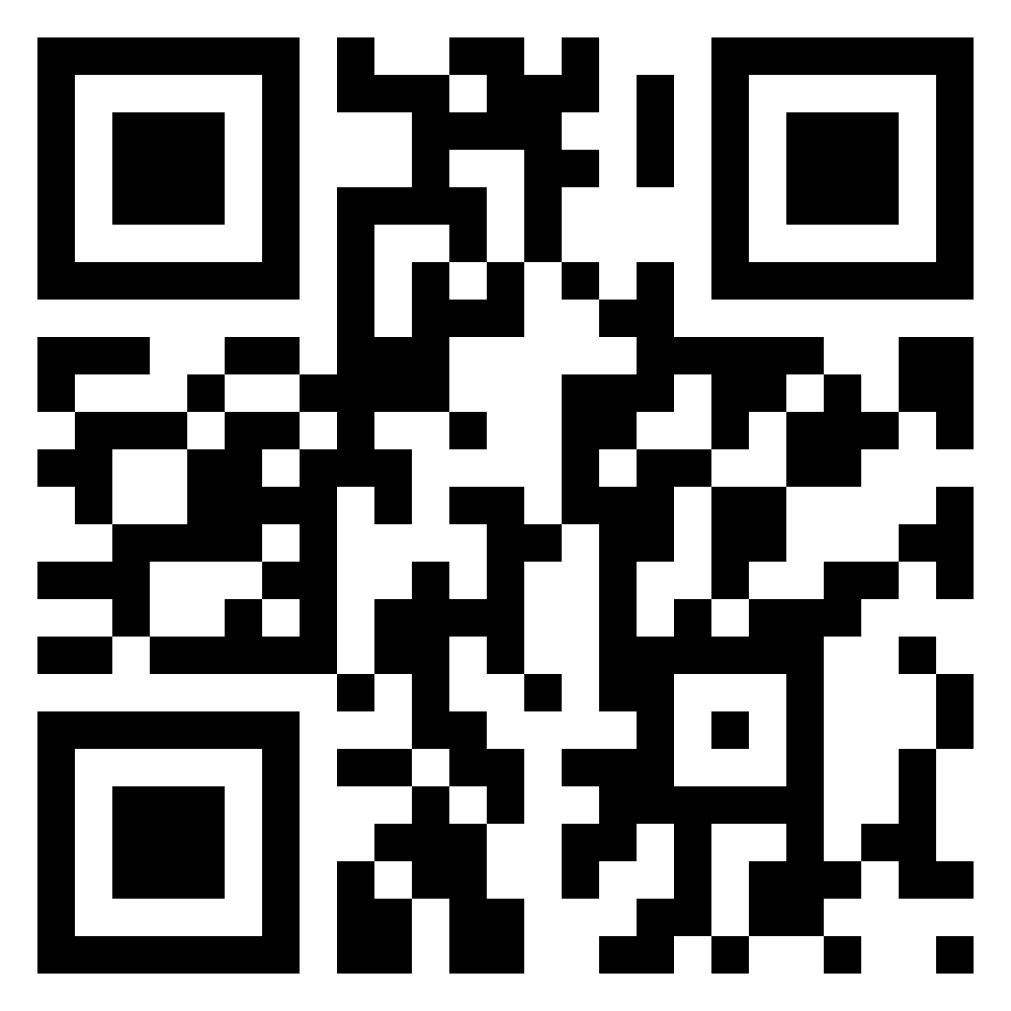


Website
ieee-sensors.org
Facebook
facebook.com/IEEESensorsCouncil
X (Twitter)
@SensorsCouncil
LinkedIn
Stay up to date on Sensors Council news and events!
linkedin.com/company/ieee-sensors-council
YouTube
Bit.ly/SensorsCouncilYouTube
Publicity Resources
ieee-sensors.org/publicity-documents/

